Slide 1
REQUEST FOR PROPOSAL NO. HSS-25-016 AMERICORPS
FORMULA GRANT APPLICATIONS:
2025-2026
for
Division of Social Services

Slide 2

REQUEST FOR PROPOSAL NO.
AMERICORPS REQUEST
FOR
FORMULA GRANT APPLICATIONS: 2025-26
FOR
DIVISION OF Social Services
Department of Health and Social Services Division of Social Services
State Office of Volunteerism/AmeriCorps Competitive and Formula Grants

Slide 3

INFORMATION SESSION
This information session will explain the RFP boilerplate, the RFP process and address any questions or concerns from potential bidders.

Slide 4
STAKEHOLDERS
Delaware Health and Social Services
Division of Social Services
State Office of Volunteerism Governor’s Commission on
Community and Volunteer Service

Slide 5
State Office of Volunteerism
The State Office of Volunteerism (SOV) is Delaware's primary resource for volunteerism and national service. SOV provides statewide leadership for the promotion and encouragement of volunteerism to persons of all ages, and coordinates a variety of volunteer events, including: The Governor's Outstanding Volunteer Awards, and the Governor's Youth Volunteer Service Awards. The State Office of Volunteerism provides coordination and linkages with volunteer programs throughout the state, hosts a Volunteer Service Conference, and manages four direct volunteer service programs.
State Office of Volunteerism programs include:
AmeriCorps
Foster Grandparent Program
Volunteer Delaware 50+
Volunteer Delaware

Slide 6
Governor’s Commission on Community and Volunteer Service (GCCVS)
Established in 2004, by a Governor’s Executive Order, The Governor’s Commission on Community and Volunteer Service was established to facilitate volunteerism and service initiatives throughout the State of Delaware.
This Act consolidates the Delaware Community Service Commission (federally mandated through the Code of Federal Regulations 45 CFR 2550) with the Council of Volunteer Services.

Slide 7
GCCVS Grant Process
GCCVS is charged with administering the state’s process. The process begins with a Request for Proposals (RFP) to solicit proposals that will be considered for submission to either the National Competition or Formula funding
“Competitive funds” compete with others nationally and are decided upon by AmeriCorps, the federal agency. A minimum of 10 members is required.
Applicants that are submitted for competitive funds and are not successful could also be considered for formula funds.
“Formula funds” compete at the state level with others for federal formula funding allotment (based on population) with decisions made by GCCVS in mid to late May. A minimum of 5 members is required. Planning grants are an option.

Slide 8
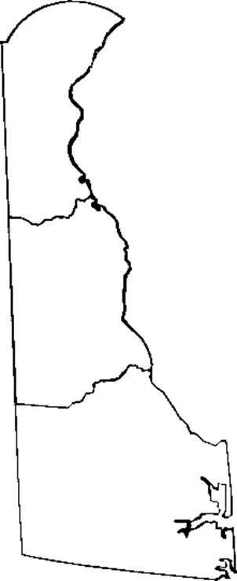
SCOPE OF SERVICES
AmeriCorps State grants support a broad range of local service programs that engage thousands of Americans in intensive service to meet critical community needs. Applicants should respond to at least one of the Focus Areas (as outlined in the 2025 AmeriCorps Notice of Funding Opportunity), which are:
Veterans and Military Families Economic Opportunity Education
Environmental Stewardship Healthy Futures Disaster Services

Slide 9
RESPONSE TO RFP
All components listed in this section are mandatory.
Proposals will be accepted until 1p.m., February 28, 2025 at which time the proposals will be opened and recorded. The proposals must include:

Slide 10
RESPONSE TO RFP
BONFIRE
https://dhss.bonfirehub.com
Vendors must register on the DHSS Bonfire Portal to access and bid on DHSS projects.
Vendors will find instructions on accessing and using Bonfire in Addenda documents posted on the bids.delaware.gov web page.

Slide 11
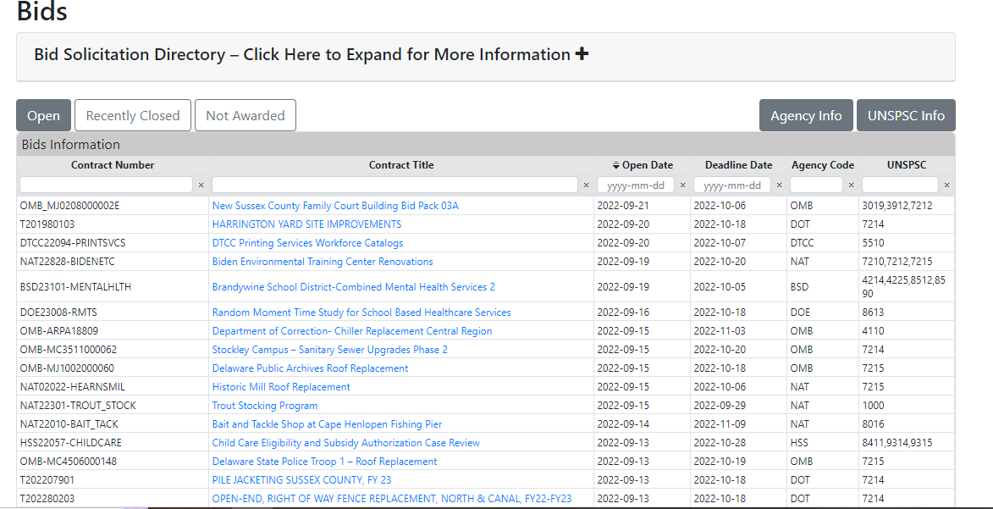

Slide 12
RESPONSE TO RFP
Transmittal Letter

Slide 13
RESPONSE TO RFP
Each proposal must be accompanied by a transmittal letter which briefly summarizes the proposing firm’s interest in providing the required professional services. The transmittal letter must also clearly state and justify any exceptions to the requirements of the RFP which the applicant may have taken in presenting the proposal. (Applicant exceptions must also be recorded on Attachment 3).

Slide 14
RESPONSE TO RFP
Transmittal Letter
Attachment 2 – Non-Collusion Statement

Slide 15
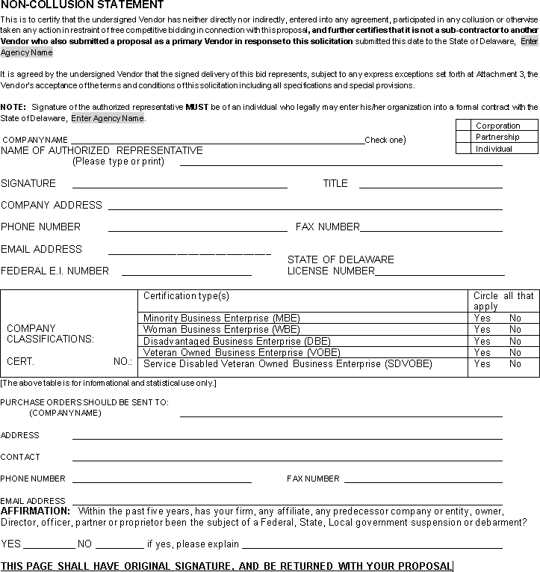
Attachment 2 - Non-Collusion Statement

Slide 16
RESPONSE TO RFP
Transmittal Letter
Attachment 2 – Non-Collusion Statement Attachment 3 – Exception Form

Slide 17
Attachment 3 – Exception Form
EXCEPTION FORM
Proposals must include all exceptions to the specifications, terms or conditions contained in this RFP. If the vendor is submitting the proposal without exceptions, please state so below.
By checking this box, the Vendor acknowledges that they take no exceptions to the specifications, terms or conditions found in this RFP.
Exception Paragraph Section and Page # | Referenced Text from RFP | Proposed Language from Vendor
Vendor Comments on Proposal
State Response
Vendor Response
State Response
Note: Vendor may use additional pages as necessary, but the format shall be the same as provided above.

Slide 18
RESPONSE TO RFP
Transmittal Letter
Attachment 2 – Non-Collusion Statement
Attachment 3 – Exception Form
Attachment 4 – Confidential Information Form

Slide 19
Confidential Information Form
By checking this box, the Vendor acknowledges that they are not providing any information they declare to be confidential or proprietary for the purpose of production under 29 Del. C. ch. 100, Delaware Freedom of Information Act.
Confidentiality and Proprietary Information
Note: Vendor may use additional pages as necessary, but the format shall be the same as provided above.

Slide 20
RESPONSE TO RFP
Transmittal Letter
Attachment 2 – Non-Collusion Statement
Attachment 3 – Exception Form
Attachment 4 – Confidential Information Form
Attachment 5 – Business References

Slide 21

BUSINESS REFERENCES
BUSINESS REFERENCES
List a minimum of three business references, including the following information:
Business Name and Mailing address
Contact Name and phone number
Number of years doing business with
Type of work performed
Please do not list any State Employee as a business reference. If you have held a State contract within the last 5 years, please provide a separate list of the contract(s).
Contact Name & Title:
Business Name:
Address:
Email:
Phone # / Fax #:
Current Vendor (YES or NO):
Years Associated & Type of Work Performed:
Contact Name & Title:
Business Name:
Address:
Email:
Phone # / Fax #:
Current Vendor (YES or NO):
Years Associated & Type of Work Performed:
Contact Name & Title:
Business Name:
Address:
Email:
Phone # / Fax #:
Current Vendor (YES or NO):
Years Associated & Type of Work Performed:

Slide 22
RESPONSE TO RFP
Transmittal Letter
Attachment 2 – Non-Collusion Statement
Attachment 3 – Exception Form
Attachment 4 – Confidential Information Form
Attachment 5 – Business References Appendix C – Letter of Intent

Slide 23
Appendix C – Letter of Intent
Basic Applicant Info
Type of Applicant (nonprofit, government, etc.):
Geographic Area of focus (city/town, county, statewide): Amount of Funds Requested:
Briefly describe the purpose of your proposed program, including the need to be addressed and the desired impact on the community (300-word limit).

Slide 24
Appendix C – Letter of Intent
Issue Areas – Which AmeriCorps focus area(s) will this program address?
Disaster Services
Economic Opportunity
Education
Environmental Stewardship
Healthy Futures
Veterans and Military Families

Slide 25
Appendix C – Letter of Intent
Describe how your program will address the following expectations of the Governor’s Commission on Community and Volunteer Service (600-word limit):
A collaborative approach to program planning, design, and delivery (examples of working with other organizations/partners):
Demonstrated ability to successfully administer an AmeriCorps or other federal grant (examples of projects or grants managed):
Addressing underserved or areas of extreme poverty that are not currently served by AmeriCorps programs (geographic and demographic references):

Slide 26
Appendix C – Letter of Intent
AMERICORPS MEMBERS: How many members (and what terms of
service) will be recruited under the proposed program?
*Note:
Planning grants are not required to fill out this portion as they will
not have members.
Full-Time (1700 hours)
Reduced Full-time (1200 hours)
Reduced Half–time (675 hours)
Half-time (900 hours)
Quarter-time (450 hours) Minimum-time (300 hours)
Total members

Slide 27
RESPONSE TO RFP
Transmittal Letter
Attachment 2 – Non-Collusion Statement
Attachment 3 – Exception Form
Attachment 4 – Confidential Information Form
Attachment 5 – Business References
Appendix C – Letter of Intent
Appendix D – Readiness Self-Assessment

Slide 28
Appendix D – Readiness Self-Assessment
Is My Organization Ready to Apply for an AmeriCorps Grant?
This Readiness Assessment asks simple questions to help you determine whether your organization is poised to successfully apply for and implement an AmeriCorps grant. Read each question carefully and answer honestly. This assessment is a tool to help you plan for the implementation and administration of an AmeriCorps grant-funded program.
Completion of the assessment does not guarantee AmeriCorps funding through GCCVS or AmeriCorps State & National. The Readiness Self-Assessment will be used by GCCVS to determine if the organization is financially ready for an AmeriCorps Grant.

Slide 29
RESPONSE TO RFP
Transmittal Letter
Attachment 2 – Non-Collusion Statement
Attachment 3 – Exception Form
Attachment 4 – Confidential Information Form
Attachment 5 – Business References
Appendix C – Letter of Intent
Appendix D – Readiness Self-Assessment
Appendix E – Verification of SAM.GOV Registration

Slide 30
Appendix E – Verification of SAM.GOV Registration
The unique entity identifier used in SAM.gov has changed.
On April 4, 2022, the unique entity identifier used across the federal government changed from the DUNS Number to the Unique Entity ID (generated by SAM.gov).
The Unique Entity ID is a 12-character alphanumeric ID assigned to an entity by SAM.gov.
As part of this transition, the DUNS # has been removed from SAM.gov.
Entity registration, searching, and data entry in SAM.gov now require use of the new Unique Entity ID.
Existing registered entities can find their Unique Entity ID by following the steps:
GSAFSD Tier 0 Knowledge Base - How can I view my Unique Entity ID?
New entities can get their Unique Entity ID at SAM.gov and, if required, complete an entity registration.
Please refer to the WORD document (same as noted in Appendix E of the RFP document) for SAM.gov entity registration and Points of Contact documents as a separate file in Bonfire entitled “Appendix E Sam.gov Registration.docx.

Slide 31
RESPONSE TO RFP
Transmittal Letter
Attachment 2 – Non-Collusion Statement
Attachment 3 – Exception Form
Attachment 4 – Confidential Information Form
Attachment 5 – Business References
Appendix C – Letter of Intent
Appendix D – Readiness Self-Assessment
Appendix E – Verification of SAM.GOV Registration Mandatory Four Questions

Slide 32
Mandatory Questions

Slide 33
RESPONSE TO RFP
Transmittal Letter
Attachment 2 – Non-Collusion Statement
Attachment 3 – Exception Form
Attachment 4 – Confidential Information Form
Attachment 5 – Business References
Appendix C – Letter of Intent
Appendix D – Readiness Self-Assessment
Appendix E – Verification of SAM.GOV Registration
Mandatory Questions

Slide 34
RESPONSE TO RFP
ALL PROPOSALS MUST BE SUBMITTED ONLINE at
https://dhss.bonfirehub.com/ Responses submitted by hard copy, mail, facsimile, or e-mail will not be accepted.
Selected proposals will be notified of award by April 1, 2025 and will be eligible to submit the Application for AmeriCorps the Agency funding.

Slide 35
TIMELINE
The schedule of events subject to the RFP is outlined below:
Public Notice Date:
Deadline for Questions Date:
Response to Questions Posted by:
Deadline for Receipt of Proposals Date:
January 3, 2025
January 17, 2025
January 31, 2025
February 28, 2025
at 1:00 PM EST Time
Estimated Notification of RFP Award Date: April 1, 2025

Slide 36
Please Remember
Restrictions on Communications with State Staff
From the issue date of this RFP until a contractor is selected and the selection is announced, bidders are NOT allowed to contact any Division of Social Services staff, except those specified in this RFP, regarding this procurement. Questions must be submitted in writing and will be addressed in writing.
Questions are due by January 17th. The complete list of questions and their answers will be released via e-mail or fax to the vendors that submitted any questions or participated in the webinar information sessions. The complete list of questions and their answers will also be posted on the internet, January 31st at http://bids.delaware.gov
Following the questions deadline, communication with bidder(s) is limited to Eddie Mui at the Delaware Health and Social Services via email: DHSS_DMS_dmsprocure@delaware.gov.

