Slide 1
Delaware Army National Guard Preliminary Microgrid Assessment
Jim Reilly
Electrical Engineer, NREL
04/19/2019

Slide 2
DEARNG Site Overview
Microgrid Requirements and Assumptions
Major System Considerations
Diesel and Solar PV Microgrid
Diesel, Solar PV, and BESS Microgrid
Conceptual Sequence of Operations
Major Operating Modes

Slide 3
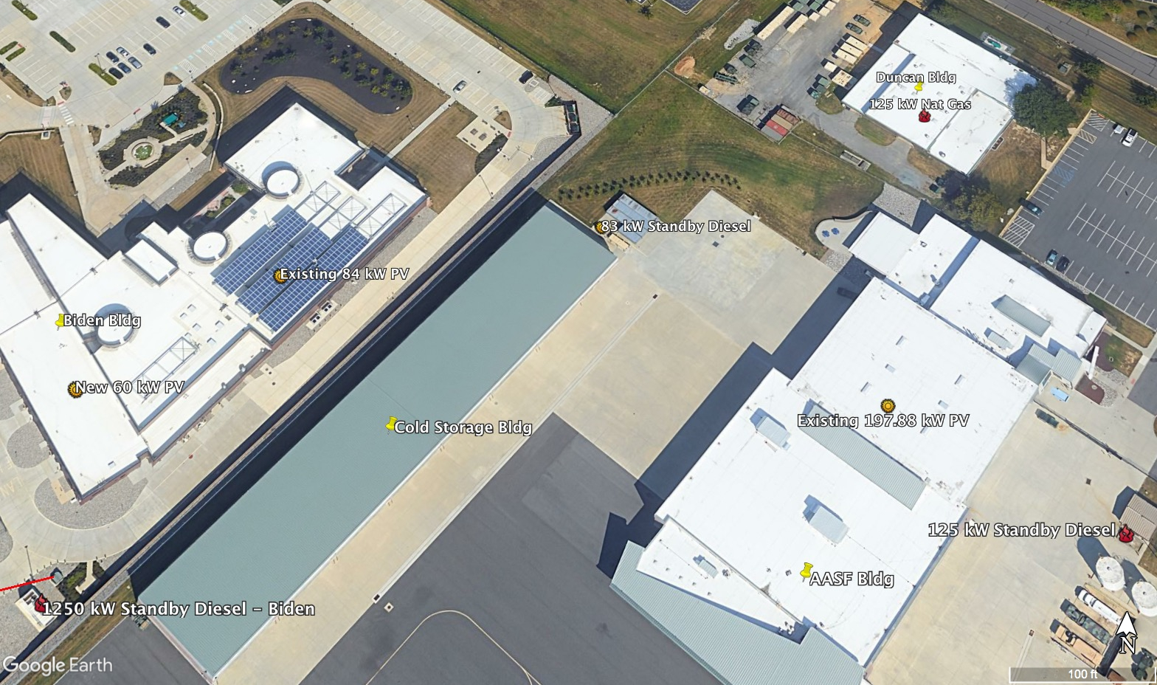
DEARNG Overview
DEARNG HQ
New Castle, DE
Local Utility
DELMARVA (PEPCO/Exelon)
Existing Onsite Generation
Biden building
1250 kW Standby Diesel
84 kW Solar PV - Existing
140 kW Solar PV - Planned
Army Aviation Support Facility
125 kW Standby Natural Gas
198 kW Solar PV - Existing
Duncan Bldg
125 kW Standby Diesel
DEARNG Energy Overview Map

Slide 4
Existing Electrical
Existing Electrical Distribution System
In the electrical existing configuration Biden is electrically isolated from the other DEARNG facilities
Existing Transformer capacities add to 4 MVA
Biden = 1500 kVA
Duncan = 1000 kVA
AASF = 500 kVA
Cold Storage = 1000 kVA
Existing Onsite Generation
Biden building
Standby Diesel Generator - 1250 kW
Existing Solar PV - 84 kW
Planned Solar PV 60 kW
Army Aviation Support Facility
Standby Natural Gas Generator - 125 kW
Existing Solar PV198 kW
Duncan Bldg
125 kW Standby Diesel
Cold Storage
83 kW Standby Diesel Generator

Slide 5
Existing Generators
All four buildings have individual diesel generators for backup
Only the 1250 kW the Biden generator was considered for inclusion in the microgrid due to cost of upgrading a generator to operate in parallel in a microgrid.
Building | Size | Type | Fuel | Notes
Biden NG/RC | 1250 kW | Diesel | 3,000 gl. | 1879 Amp, 480/277 V, 60 HZ, PH 3, KVA 1563 Mitsubishi diesel engine S12R-Y2PTAW EPA Tier 2, 1800 rpm
AASF | 12k kW | Diesel |  | Model 125RE0ZJD, serial #2290505
AASF Cold Storage | 83 kW | Diesel |  | Kohler Model # GM81567-GA3, serial #SGM327SB8
Duncan RC | 150 kW | Natural Gas |  | Cummins Model# 150 GFPA, aerial # M15A045366

Slide 6
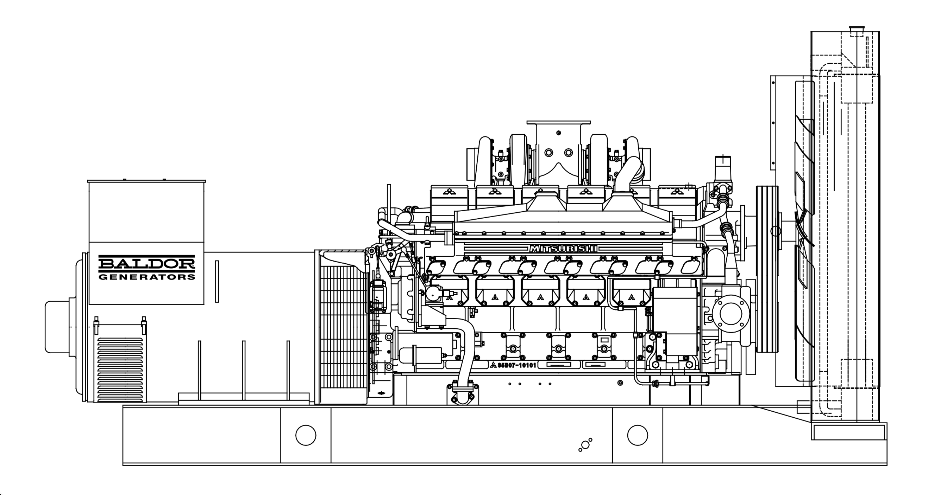
Biden 1250 kW Generator
Biden NG/RC: 1250 KW Diesel, 2500 gallon belly tank
Manufacturer = Baldor.
Model = IDLC1250-2MU
1879 Amp, 480/277 V, 60 HZ, PH 3, KVA 1563
Mitsubishi diesel engine
S12R-Y2PTAW
EPA Tier2, 1800 rpm
Serial Number = P1305010004
SkVA output with 30% voltage dip max = 3800 kVA
100% recovery at 60 Hz
Onboard Intelligen digital controller
Baldor contact unsure of parallel capabilities without site visit

Slide 7
Existing Solar PV
Existing/Planned | Building | Size (kW AC) | Inverters | Notes
Existing | Biden NG/RC | 84 kW | Solar Edge SE20KUS and SE33.3KUS | Ethernet and serial ports for monitoring, no control functions
Planned | Biden NG/RC | 140 kW | Solar Edge SE20KUS and SE33.3KUS | Ethernet and serial ports for monitoring, no control function
Existing | AASF | 198 kW | ABB Trio 27.6 and 50 kVA | Two serial ports for monitoring, no control functions

Slide 8
Microgrid Requirements and Concept
Number of loads to include in Microgrid = 4
Peak Load = 607 kW (2017)
Average Load = 275 kW
Existing Transformer Capacity = 4000 kVA
Automated System with Minimal manual Switching
Ability to island DEARNG loads without impacting DELMARVA distribution
Adhere to DOD Risk Management Framework (RMF) Cyber Security Authority to Operate (ATO) Process
Utilize existing generation when possible
Extend existing fuel supply in support of 14-day Army directive
Two main microgrid scenarios
Solar PV and Diesel microgrid
Solar PV, Diesel, and Battery Energy Storage Systems (BESS) microgrid

Slide 9
Generator Considerations
Automatic Transfer Switch (ATS) – The existing ATS is a 2-pole ATS not capable of parallel operation with the distribution system. A paralleling switchgear breaker configuration should be installed to enable paralleling of the two sources, distribution system and generator, while also ensuring isolation from the external utility supply
Gen Controller – It is recommended to upgrade the existing onboard generator controller to allow for reliable integration of the existing
Local Master Controller – a local master controller to operate the 1250 kW generator and associated switching components is required.
In the event of loss of communications with the microgrid controller or a fault on the system, the master controller will operate the standby generator and paralleling switchgear independent from the other systems to ensure that Biden loads are covered as they currently are in building-tied outage mode.
Environmental should not be a major concern as the generator will still only perform as a standby asset

Slide 10
Distribution Considerations
DELMARVA stated at Feb 28, 2019 meeting that DEARNG-owned microgrid control system is not allowed to control components on DELMARVA Power distribution network
DEARNG buildings are not currently electrically connected through a circuit that can be isolated. Upgrades are required to enable islanding of DEARNG loads.
Lowest cost solution is likely to increase supply conductor rating to Biden building to 4/0 AL and construct new distribution tie on DEARNG property to connect buildings and make primary serve point at Biden building Point of Common Coupling (PCC).
Existing fused service points become secondary source.
During microgrid energization after an outage (blackstart), enough generation must be available to energize transformers and absorb in-rush currents
Current generator has a motor start rating (SkVA) of 3800 kVA at 30% voltage drop for 60 Hz.
Transformers and loads on DEARNG system must be brought online in coordinated steps.
DEARNG microgrid must not parallel with DELMARVA system.
Microgrid operation will likely need to be closely coordinated with DELMARVA system operators
Existing underground 1/0 AL conductor serving Biden transformer is estimated to have an ampacity between 150-175 Amps
Switching or protection devices should be installed to enable remote operation of switching to isolate the DEARNG system
This conceptual design assumes 15 kV reclosers due to cost and increased functionality.
Reclosers serve to open express feeders between buildings when existing fuse supply is utilized.
Biden transformer may temporarily be overloaded during blackstart of the system. Transformers have a short-duration overload period, but DELMARVA may require upgrade to 2000 kVA transformer during Interconnection Application process.

Slide 11
Solar PV Considerations
Fiber optic cable should be routed to the mechanical rooms housing inverters for AASF and Biden to enable monitor solar PV inverter output.
Optional hardware or firmware upgrades may be required to enable monitoring of solar PV inverters at AASF.
A Programmable Logic Controller could be used to control AC circuit breakers for AASF solar PV arrays to enable curtailment of the systems if necessary during island mode to ensure adequate power quality.

Slide 12
Other Considerations
O&M of the control system must be considered. This microgrid will require trained personnel for advanced operation adjustments, system updates, and routine maintenance.
O&M can be obtained by trained DEARNG personnel, or through a contract with an experienced third-party.
Cyber Security of the system will be a significant consideration during the initial design, construction, and commissioning process; and annual or bi-annual recertification of the Authority to Operate is a requirement of the Risk Management Framework process.
During the February 28th meetings, DEARNG communications staff requested that the microgrid control system should remain air-gapped from the Building Automation Systems

Slide 13
Microgrid Scenarios Investigated
Solar PV and Diesel microgrid
1250 kW Standby Diesel Generator
437 kW Solar PV
Solar PV, Diesel, and Battery Energy Storage Systems (BESS) microgrid
1250 kW Standby Diesel Generator
437 kW Solar PV
700 kW : 1400 kWh BESS

Slide 14
Proposed Microgrid Diesel + PV
Conceptual Operation
Grid outage occurs on DELMARVA System.
PV Inverters trip offline (IEEE 1547).
DEARNG standby generators come online as normal.
Biden utility AC circuit breakers are open.
Microgrid controller requests permission to isolate from DELMARVA system operators.
Microgrid controller initiates isolation by opening Recloser 1 (R1), if not open already.
Biden AC supply circuit breaker closes, energizing 1500 kVA transformer for Biden.
Brief pause to stabilize system (likely 1-5 seconds).
Recloser 2 (R2) closes to energize Duncan 1000 kVA transformer and loads.
Brief pause to stabilize system (likely 1-5 seconds)
Recloser 3 (R3) closes to energize AASF 33 500 kVA transformer and loads.
Brief pause to stabilize system (likely 1-5 seconds)
Recloser 4 (R4) closes to energize Cold Storage 1000 kVA transformer and loads.
PV Inverters begin coming online after 5-minute delay
Per IEEE 1547
Microgrid controller dispatches diesel generation and solar PV to maximize solar PV while maintaining power quality
------------
DELMARVA may require open transition for return to utility.
Notes:
Do existing PV systems come online with standby diesels after 5-minute delay? Still unsure as of 04/19/2019 - JR

Slide 15
Proposed Microgrid Diesel, PV, and BESS
Conceptual Operation
Grid instability is sensed on DELMARVA system.
Recloser 1 opens and BESS picks up load for all 4 buildings.
Microgrid controller requests permission to continue microgrid operation from DELMARVA system operators.
Biden diesel generator comes online and begins to synchronize with BESS controller microgrid across paralleling switchgear.
Once BESS and standby generator are synchronized, Biden standby generator AC circuit breaker closes.
PV Inverters begin coming online after 5-minute delay
Per IEEE 1547
Microgrid controller dispatches BESS, diesel generation, and solar PV to maximize solar PV while maintaining power quality.
----
DELMARVA may not require open transition for return to utility.
Notes:
Do existing PV systems come online with standby diesels after 5-minute delay? Still unsure as of 04/19/2019 - JR

Slide 16
Operating Scenarios
Solar PV and Diesel Microgrid (some ability to extend the existing fuel supply)
In all operating scenarios the microgrid controller will dispatch diesel and curtail solar PV as needed to optimize PV generation while ensuring adequate power quality of the microgrid.
Solar PV, Diesel, and BESS Microgrid (Increased ability to further extend the existing fuel supply)
High solar/high load
Microgrid controller will dispatch diesel during times when BESS does not have adequate storage. In some instances, the diesel generator may go offline.
High solar/low load
Microgrid controller will dispatch diesel during times when BESS does not have adequate storage. If adequate energy storage is available, the diesel generator may go offline for extended periods of time.
Low solar/high load
Diesel generation will be primary source of power until adequate energy storage is available in the BESS or from solar PV.
Low solar/low load
Diesel generation will come online as necessary

Slide 17
Questions:
James Reilly
James.reilly@nrel.gov

Slide 18
Appendix

Slide 19
Disclaimer
This document was prepared as an account of work sponsored by an agency of the United States government. Neither the United States government nor any agency thereof, nor any of their employees, makes any warranty, express or implied, or assumes any legal liability or responsibility for the accuracy, completeness, or usefulness of any information, apparatus, product, or process disclosed, or represents that its use would not infringe privately owned rights. Reference herein to any specific commercial product, process, or service by trade name, trademark, manufacturer, or otherwise does not necessarily constitute or imply its endorsement, recommendation, or favoring by the United States government or any agency thereof. The views and opinions of authors expressed herein do not necessarily state or reflect those of the United States government or any agency thereof.
This analysis relies on site information provided to NREL by the Army that has not been independently validated by NREL.
The analysis results are not intended to be the sole basis of investment, policy, or regulatory decisions.
This screening identifies high-level considerations and should be treated as an initial step in microgrid design to prioritize and focus future designs on technical solutions with more rigorous detail.
The data, results, conclusions, and interpretations presented in this document have not been reviewed by technical experts outside NREL or the Army.
This preliminary version of analysis was conducted for internal use only and is not intended for public use. The data, results, conclusions and interpretations presented in this document should not be disseminated, quoted, or cited.

Slide 20
Microgrid Components
Generation:
1250 kW Existing diesel generator
Only includes 3,000 gallons of diesel fuel
Existing and planned PV
Assume there is no room for additional PV
Could increase PV size to meet 100% of annual load under net metering agreement
Storage
700 kW/1400kWh
Energizing:
Existing generation is sufficient to energize the transformers during start-up
Other upgrades:
Microgrid controllers
Fiber to PV
Distribution lines to connect the buildings

Slide 21
Solar PV Spec Sheets
Biden
20 and 30 kVA
Solar Edge Three Phase Inverters For the 277/480V Grid for North America; SE10KUS, SE20KUS, SE30KUS, SE33.3KUS
AASF
27.6 kVA
ABB TRIO-20.0/27.6-TL-OUTD
50 kVA
ABB TRIO-50.0-TL-OUTD / TRIO-60.0-TL-OUTD-480

Slide 22
Comparable Biden 1250 kW Spec Sheet
Baldor IDLC1250-M series generators

